Slide 1
Digital Portfolio
STUDENT NAME: Dhivakaran.E
REGISTER NO AND NMID: 32124U18017 & 78746A8E6CBD4698E93402820672D36A
DEPARTMENT: BSC COMPUTER SCIENCE
COLLEGE: MUTHURANGAM GOVERNMENT ARTS AN SCIENCE COLLEGE/THIRUVALLUVAR UNIVERSITY

Slide 2
PROJECT TITLE 📷My photography portfolio
Notes:
My project about my portfolio photography

Slide 3


AGENDA
1.Introduction
2.Showcase of work
3.Behind the lens
4.project an collection
5.Achivements
6.contact information
7.Closing section
3/21/2024 Annual Review

Slide 4

PROBLEM STATEMENT
The problem is the lack of a centralized, visually appealing, and user-friendly portfolio that can:
📷Showcase diverse categories of photography work
📷Highlight the photographer’s skills, projects, and achievements
📷Provide easy access to contact details and services.
📷 Establish a strong professional identity.

Slide 5

PROJECT OVERVIEW
By developing this portfolio, I aim to
📷Establish a strong personal brand in the field of photography.
📷 my work in a structured and engaging manner
📷Provide an easy way for potential clients and collaborators to view my services and contact me
📷Build credibility through testimonials, recognitions, and project showcases.

Slide 6

WHO ARE THE END USERS?
1.Potential client
📷Individual organizations looking to hire a photographer for events, portraits, products, or commercial work.
.2. Collaborators / Creative Partners
📷 Other photographers, designers, models, makeup artists, or brands who may want to collaborate.
📷They will look for your past projects and artistic style to see
3. Agencies / Recruiters
📷media agencies, advertising firms, or talent scouts who may want to feature your work or hire you for campaigns. They focus on credibility, achievements, and versatility
4.versatilityGeneral Audience / Followers
📷Photography enthusiasts, friends, and the public who admire creative work.
📷 They provide appreciation, recognition, and support — helping build your personal brand.

Slide 7
POTFOLIO DESIGN AND LAYOUT
1.Home page an landing page
2.Portfolio /gallery page
3.Categories/ filters
4.About page
5.Design principle
6.Contact page
7

Slide 8
FEATURES AND FUNCTIONALITY
Image Display
📷 Responsive Gallery (auto-adjusts to screen size)
📷.Light box Viewer (click a photo → enlarged full screen view
📷.Slideshow Mode (users can flip through your work).—
2. Navigation & Organization
📷Category Filters (Portrait | Street | Events | Nature)
📷Search Functionality (search by keyword, tag, or location).Pagination / Infinite Scroll (load more photos smoothly)
3. User Interaction
📷 Hover Effects (show title, location, camera settings on hover).Like/Favorite Button (optional for engagement)

Slide 9

RESULTS
Design & Layout Outcome
📷A minimalist, clean website design that highlights photos without distractions.
📷Created grid-based gallery pages with filters (Portrait, Landscape, Street, Events).Integrated light box functionality for full screen viewing.
2.User Experience Results
📷 Visitors can easily navigate between portfolio categories.
📷 Smooth sideshow & zoom features improve engagement.
📷Faster image loading with lazy load optimization. Positive feedback from peers/test users on simplicity and clarity.
3/21/2024 Annual Review
9

Slide 10
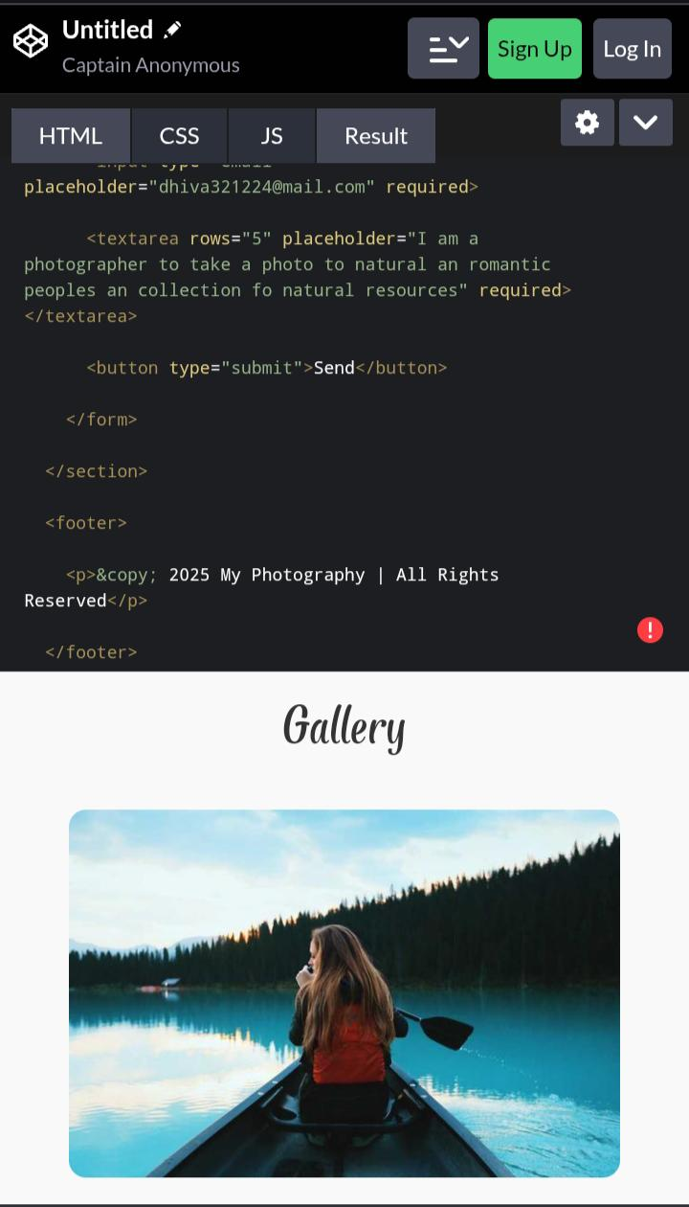
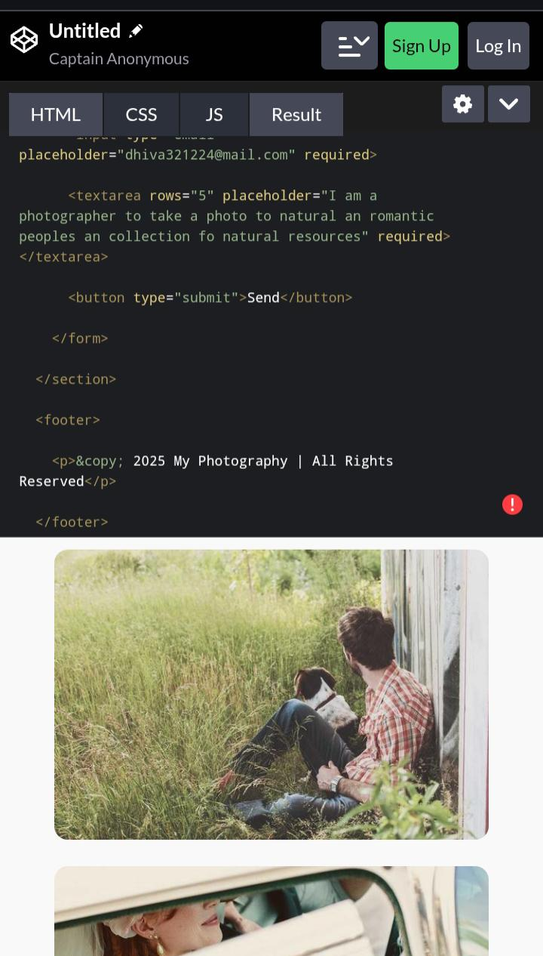
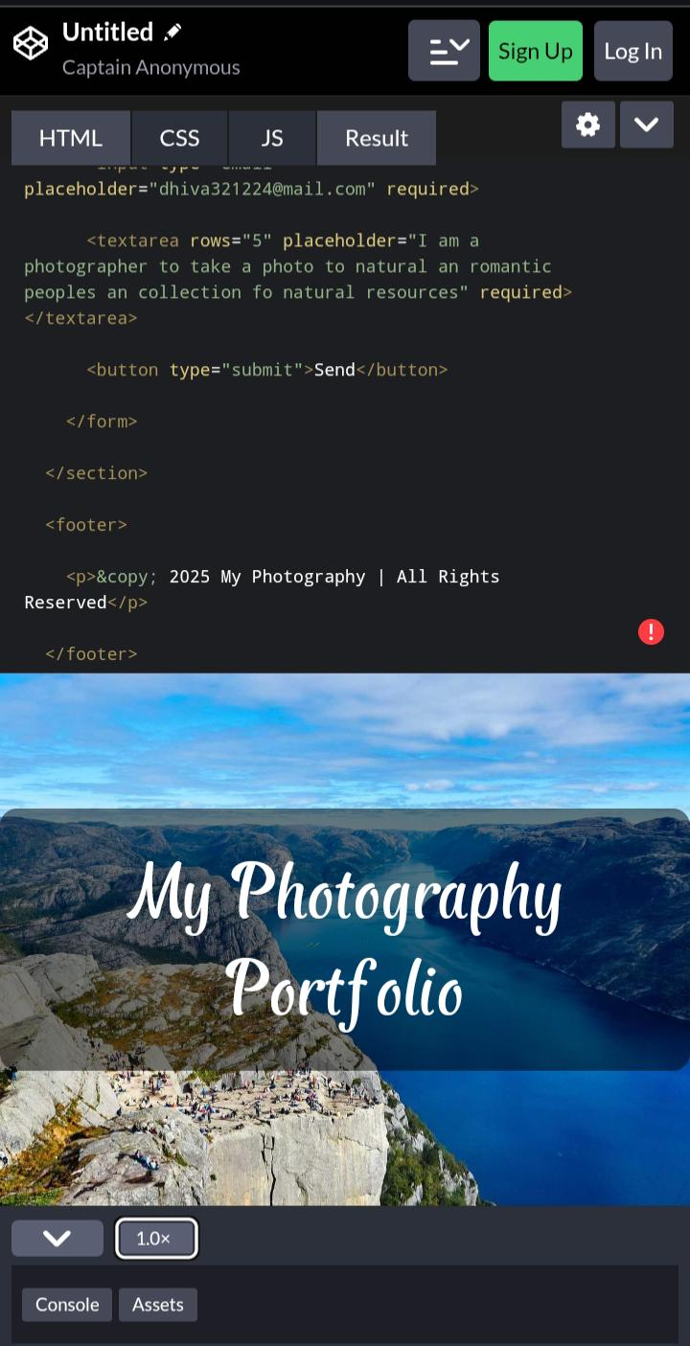
SCREENSHOTS
3/21/2024 Annual Review
10

Slide 11
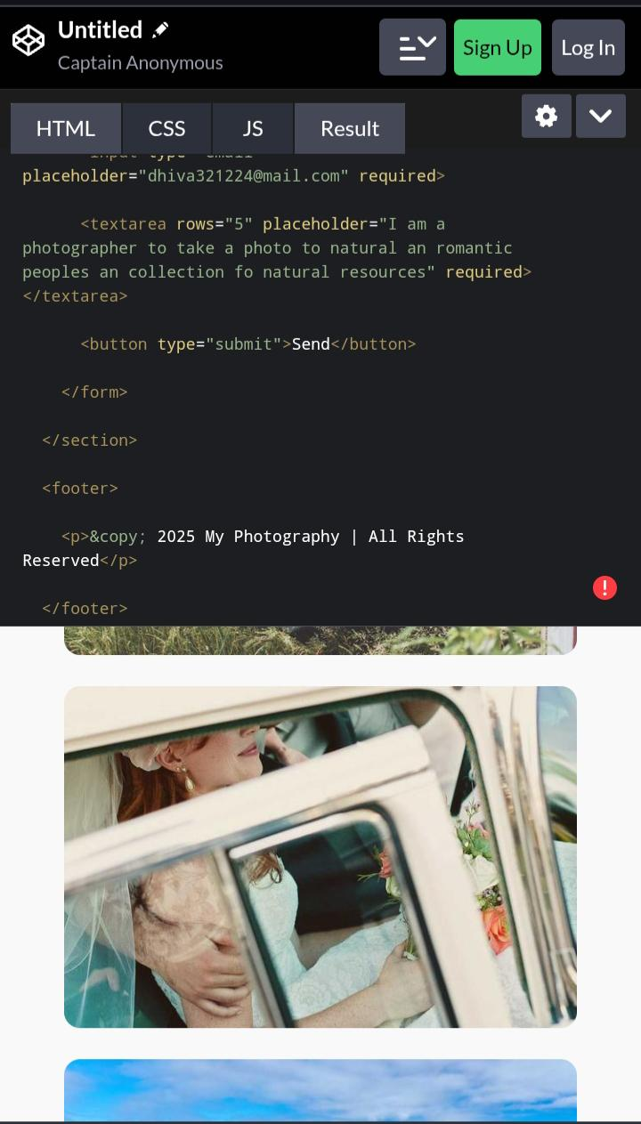
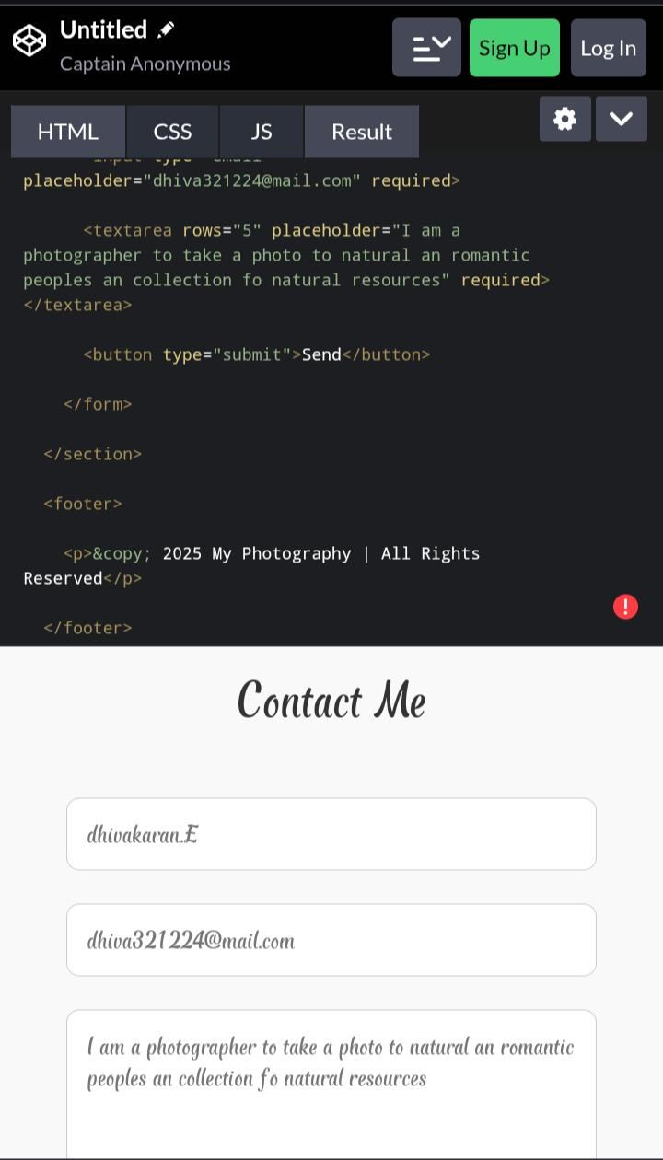
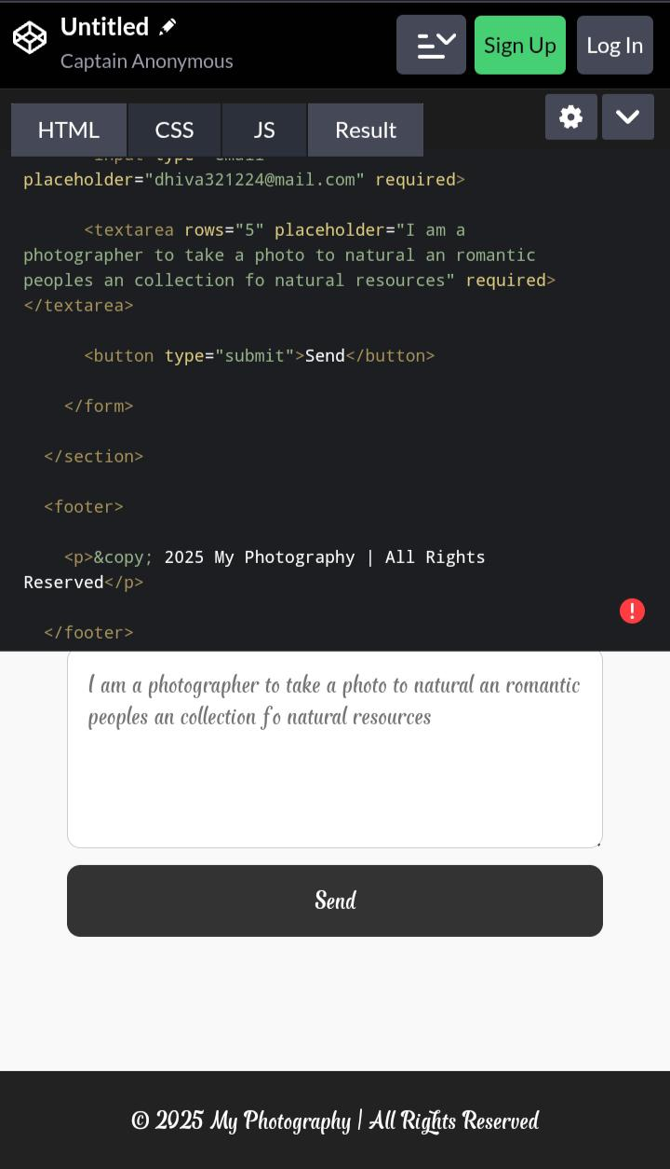
SCREENSHOTS
3/21/2024 Annual Review
11

Slide 12
CONCLUSION
✨The photography portfolio project successfully demonstrates how design, functionality, and creativity can be combined to showcase photographic work in a professional manner.
✨By creating a clean and responsive layout, the portfolio allows viewers to focus on the images without unnecessary distractions.
✨Features such as category filters, lightbox viewing, and social media integration enhance user experience while ensuring easy navigation.
✨This project not only highlights technical skills in web design and development but also reflects personal creativity, style, and storytelling through photography.
✨The portfolio serves as a digital platform to share work with potential clients, peers, and the public, while also offering opportunities for professional growth.
✨In conclusion, the project achieved its objective of building an effective, user-friendly, and visually engaging photography portfolio that can be expanded and refined in the future.
12

Slide 13
GITHUB LINK

